Slide 1

Project Title
Crafting Compelling
Web Presences

Slide 2
Project Overview
In this immersive project, you'll dive deep into the intricacies of website design, exploring the fundamental elements that make websites tick. From understanding the inner workings of websites to deciphering the essential design principles, you'll uncover the key ingredients necessary to create a standout online presence.
But it won't stop there. Through a series of hands-on activities and real-time exercises, you'll put theory into practice as you roll up your sleeves and build websites and landing pages from scratch. Armed with a toolkit of digital marketing strategies and best practices in website design, you'll breathe life into your creations, turning ideas into interactive digital experiences.
As a Digital Marketing Intern, exploring the fundamentals of digital marketing as this project is designed to help you understand website dynamics and essential design principles, enabling you to create compelling web presences. Through practical tasks, you'll learn to build websites and landing pages from scratch, applying digital marketing strategies for effective online engagement.

Slide 3
TASK 1 Understand their products or services and create short descriptions for a minimum of 3 and a
maximum of 5 products or services.
Certainly, Here I’m considering myself as a digital marketing intern at Apple company
iPhone 13 Pro Max: The iPhone 13 Pro Max epitomizes cutting-edge technology and seamless design. With its stunning Super Retina XDR display and powerful A15 Bionic chip, it offers unparalleled performance and graphics. Its Pro camera system captures breathtaking photos and videos even in low light, while its durable Ceramic Shield front glass ensures enhanced protection. With 5G capability and advanced iOS features, the iPhone 13 Pro Max redefines the smartphone experience.
AirPods Pro: AirPods Pro revolutionizes the way we experience audio. With active noise cancellation for immersive sound, Transparency mode for hearing the world around you, and a customizable fit for all-day comfort, it delivers an unparalleled listening experience. The adaptive EQ tunes music to the shape of your ear, while the sweat and water resistance make it ideal for workouts and outdoor activities. With seamless integration with Apple devices and the convenience of "Hey Siri" voice control, AirPods Pro sets a new standard for wireless earbuds.

Slide 4
3.MacBook Pro (M1 Chip): The MacBook Pro with the groundbreaking M1 chip sets new benchmarks in performance and power efficiency. Its M1 chip integrates the CPU, GPU, and Neural Engine into a single system-on-chip (SoC), delivering blazing-fast processing speeds and extraordinary battery life. The Retina display with True Tone technology provides vibrant colors and sharp details for an immersive viewing experience. With macOS Big Sur optimized for M1, along with advanced security features, the MacBook Pro offers unrivaled productivity and creativity for professionals and creatives alike.
4. Apple Watch Series 7: The Apple Watch Series 7 is the ultimate companion for a healthy and active lifestyle. Its larger and more advanced Retina display offers increased readability and more intuitive interactions. With advanced health features like blood oxygen monitoring, ECG, and sleep tracking, it empowers users to take control of their well-being. The WatchOS ecosystem provides access to a myriad of apps, from fitness and productivity to entertainment, all easily accessible from your wrist. With customizable bands and a sleek design, the Apple Watch Series 7 seamlessly blends style and functionality.

Slide 5
TASK 2 Determine the platform on which the website is developed (Use online tools to identify).
Static site generator - Next.js(12.3.0)
Ecommerce - Cart Functionality
Webmail - Apple iCloud Mail
Programming languagesc - Node.js
Maps - Apple MapKit JS(5.x.x)
Web frameworks - Next.js(12.3.0)
Web servers - Next.js(12.3.0)
JavaScript frameworks - React(17.0.1), Next.js(12.3.0)
Security - HSTS
Personalisation - Adobe Target(2.10.2)
JavaScript libraries - Preact,Lodash(4.17.21)
Analytics - Adobe Analytics
A/B Testing - Adobe Target(2.10.2)
Miscellaneous - Open Graph

Slide 6
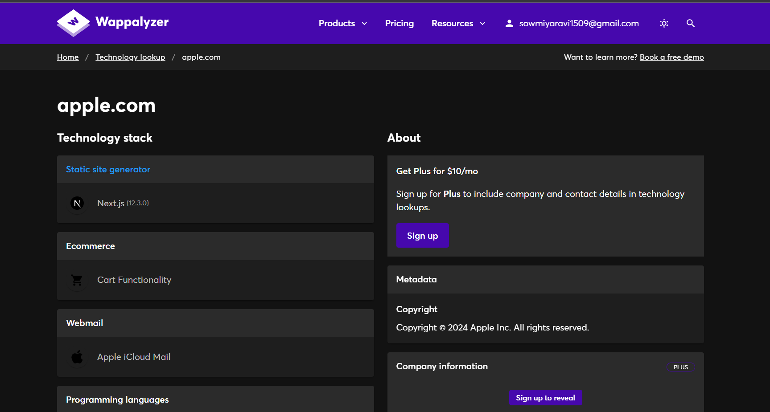
I utilized the Wappalyzer tool to determine the platform on which the Apple website is developed, and it provided the following report, which I have also attached below.

Slide 7

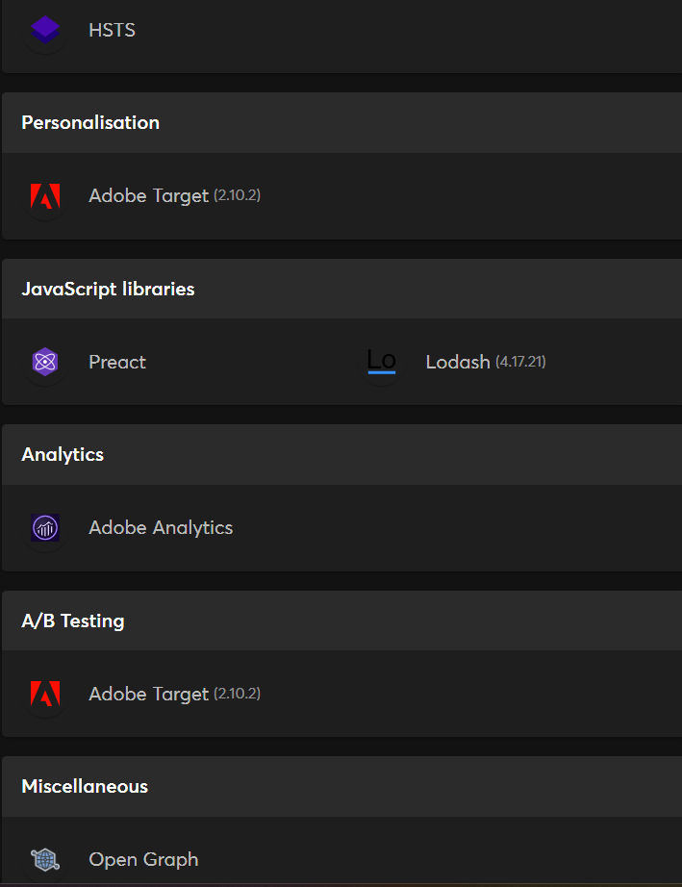

Slide 8
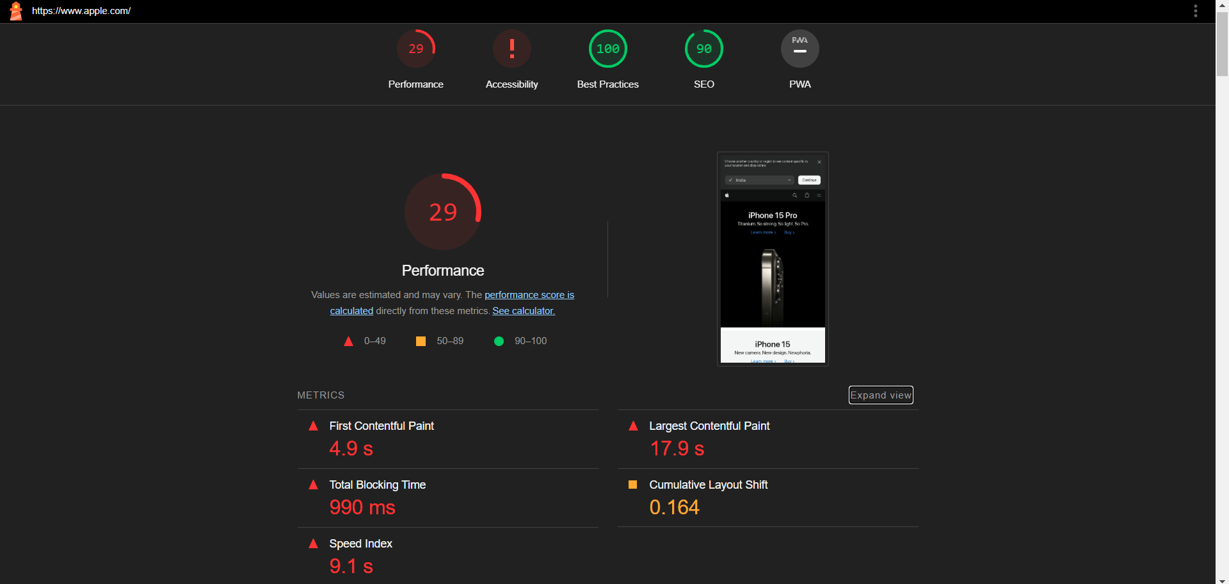
TASK 3 Test the website's responsive design and mobile optimization (using lighthouse testing tool)
PAGE: HOME

Slide 9
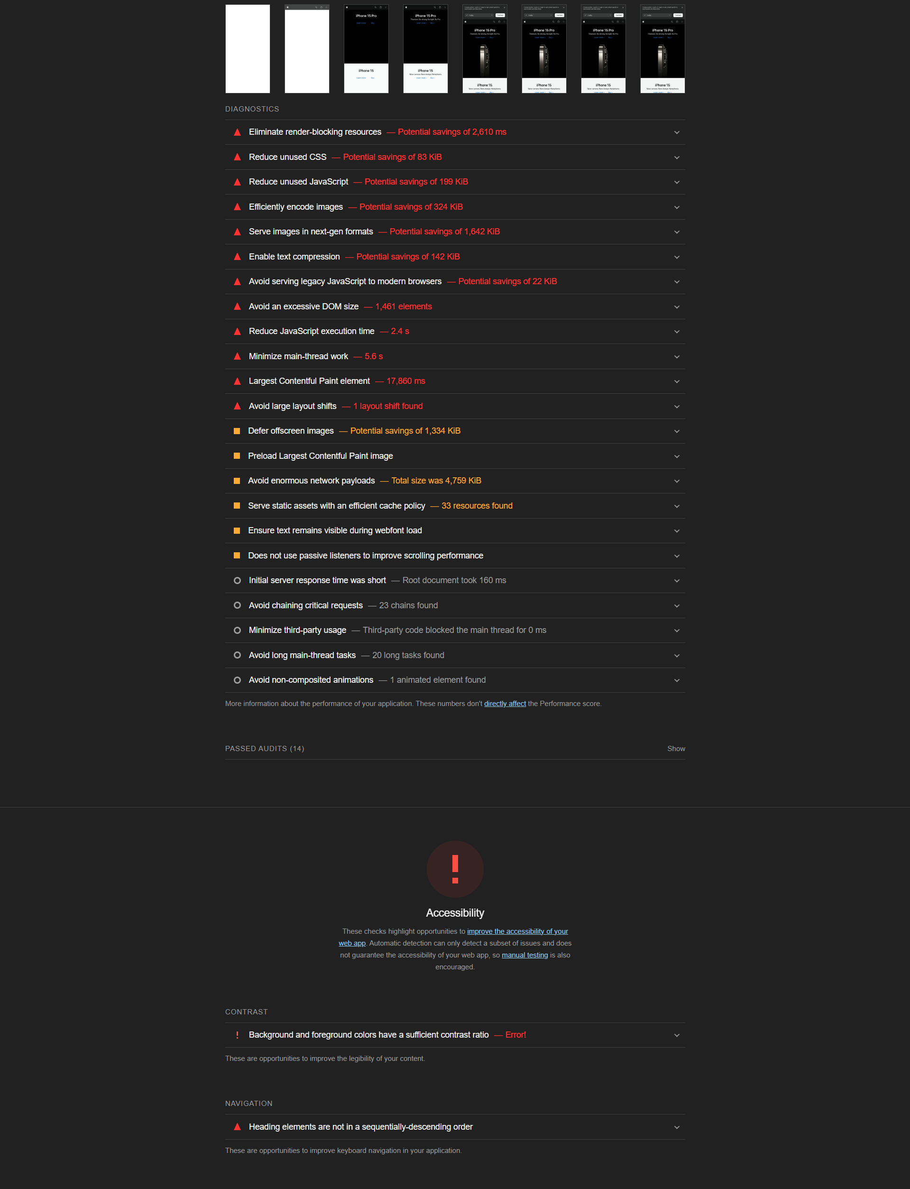
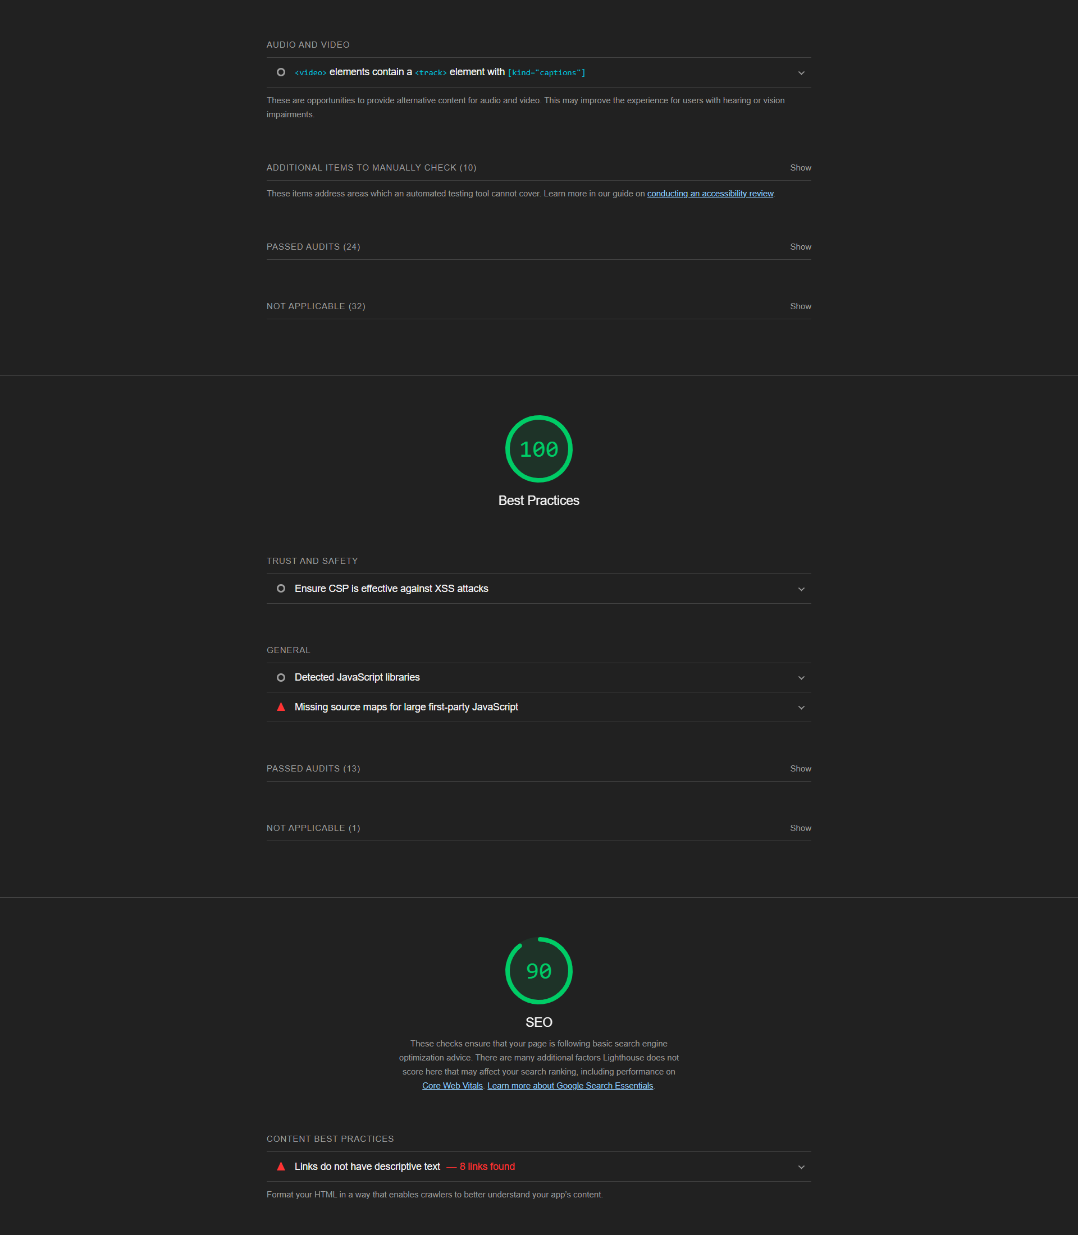
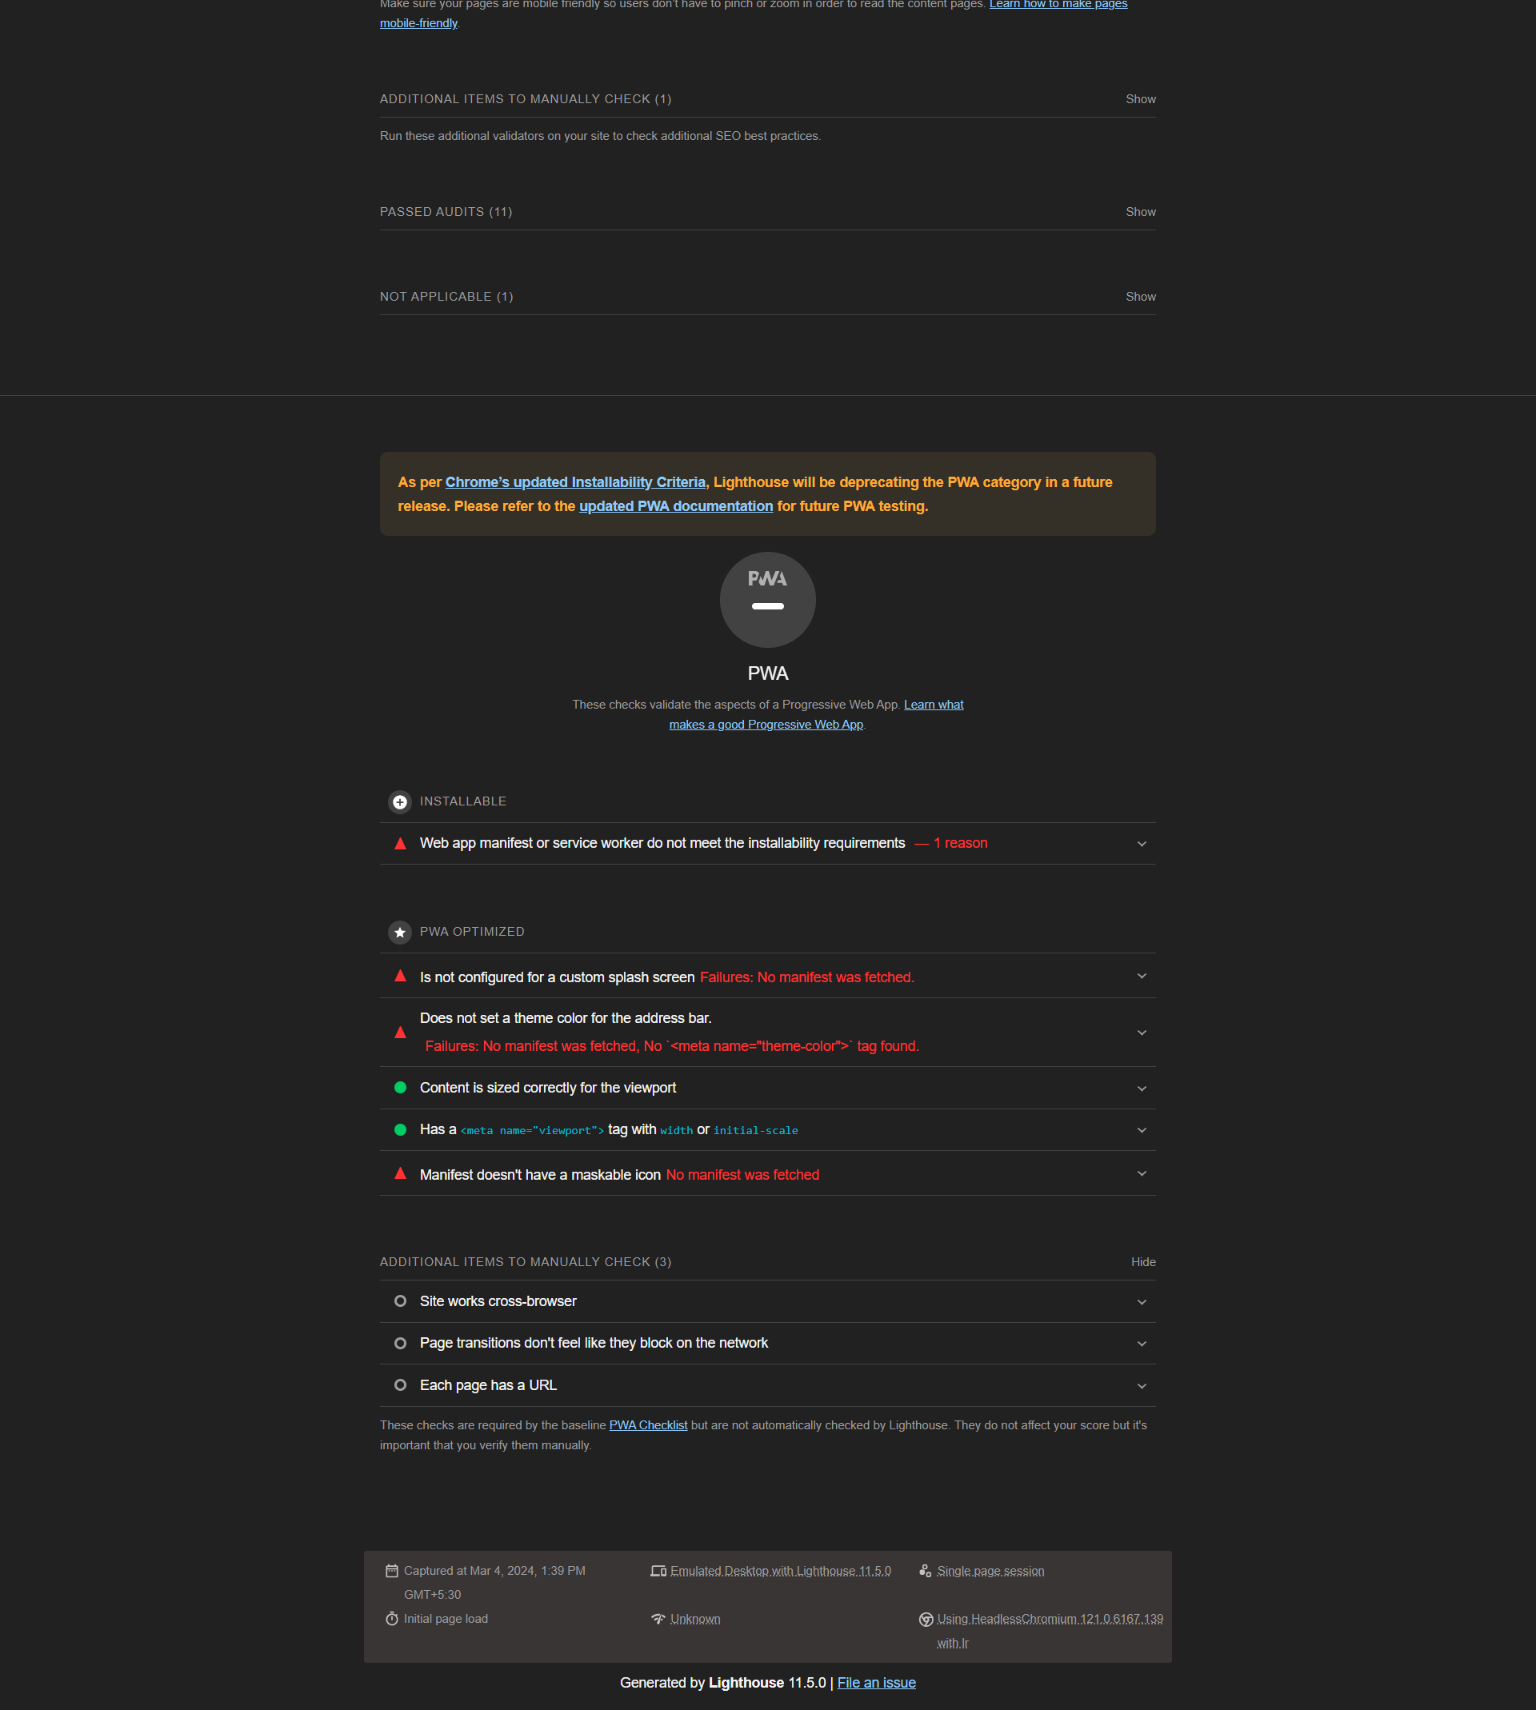

Slide 10
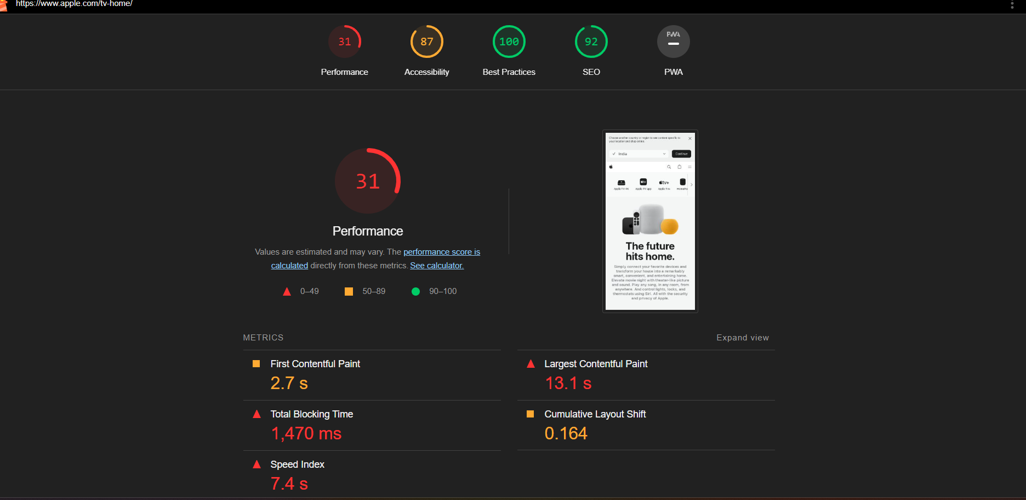
PAGE: TV & HOME

Slide 11
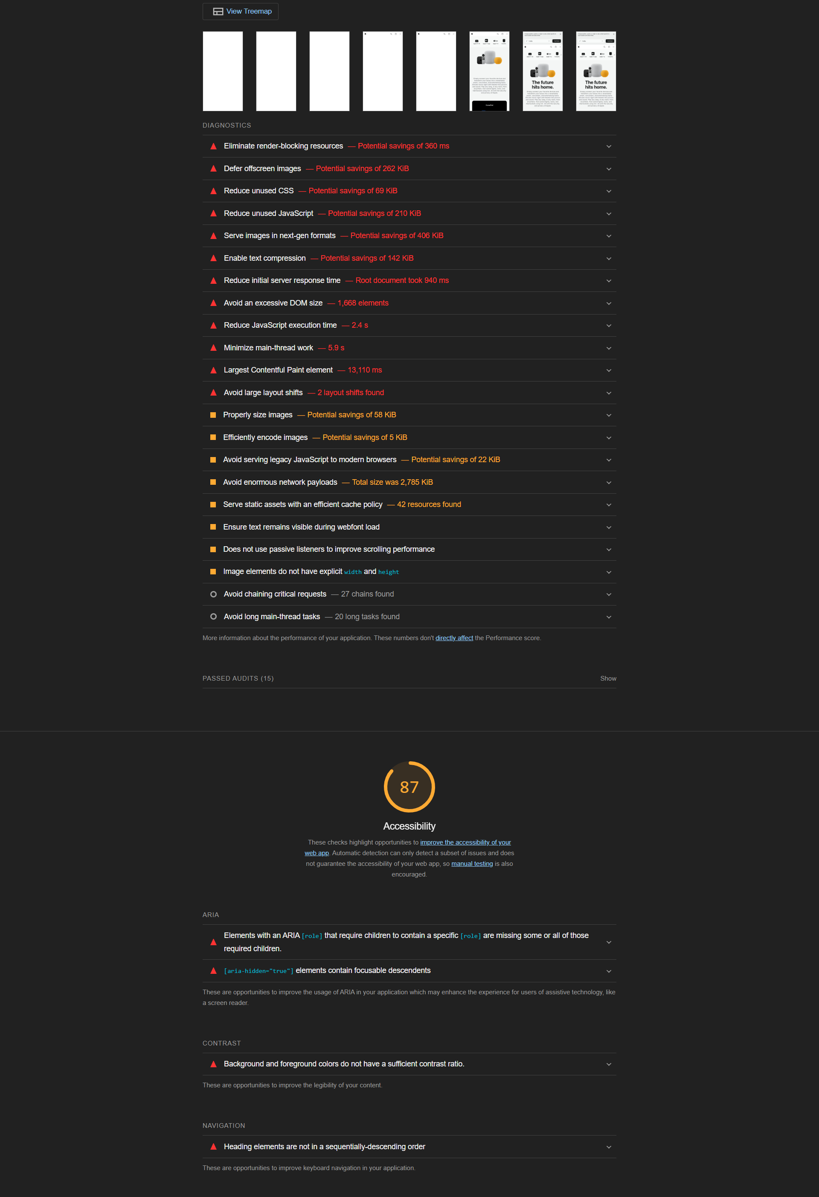
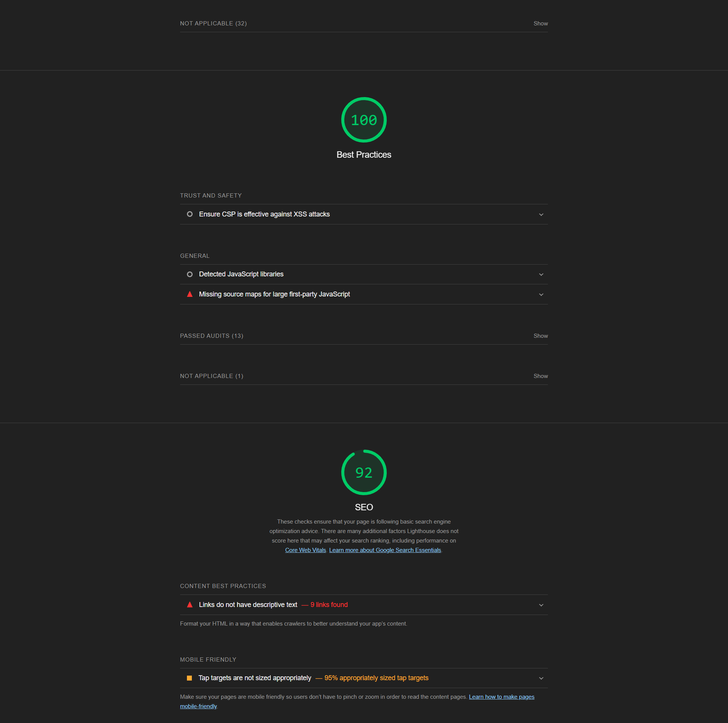
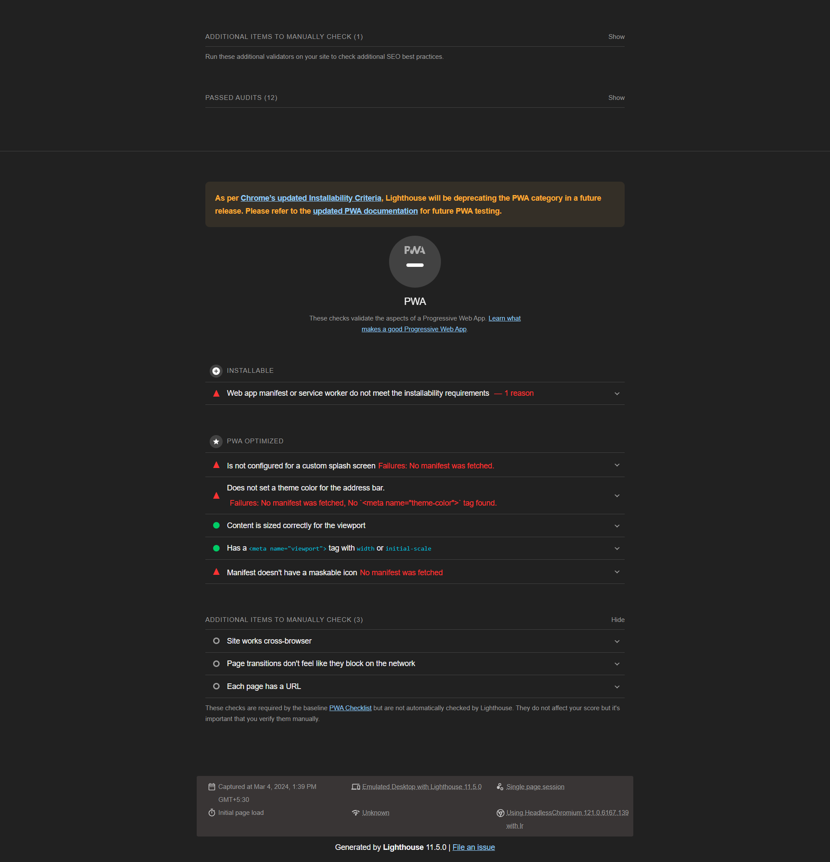

Slide 12
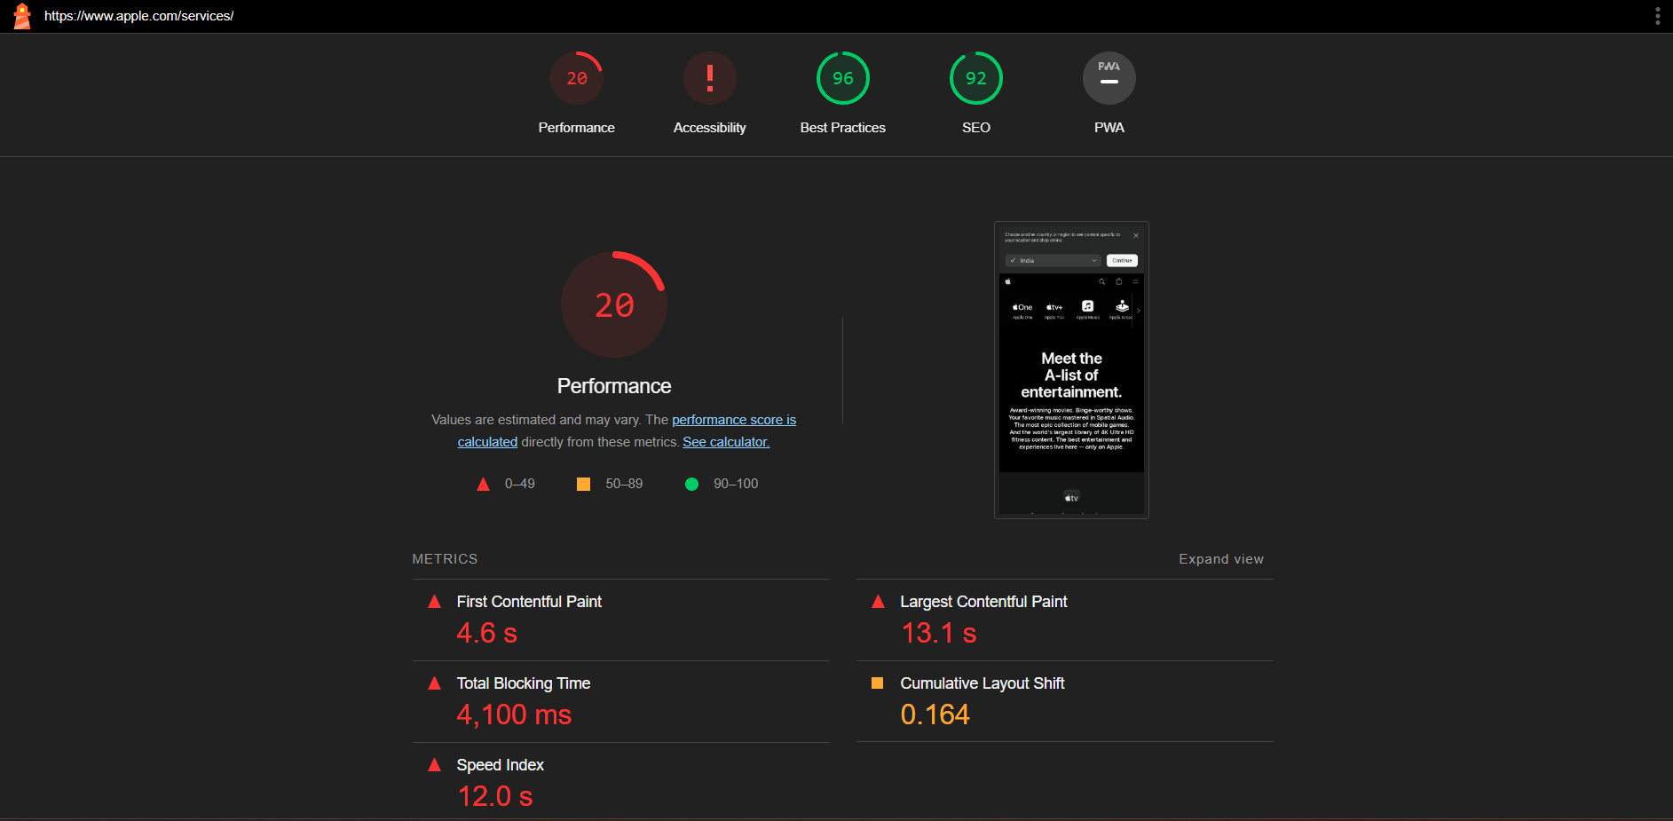
PAGE: ENTERTAINMENT

Slide 13
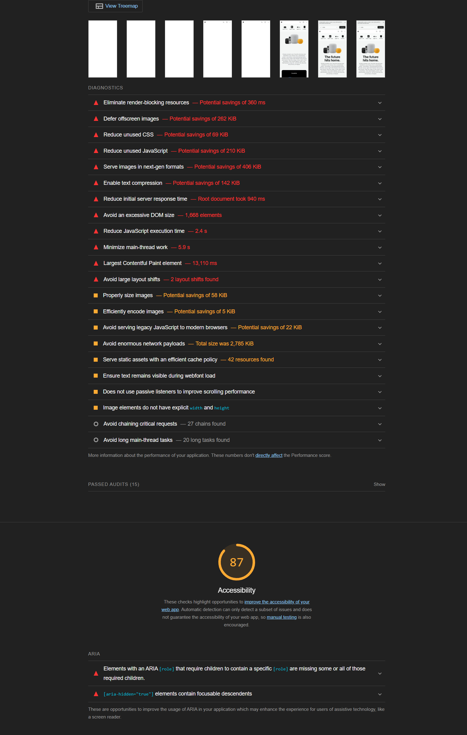
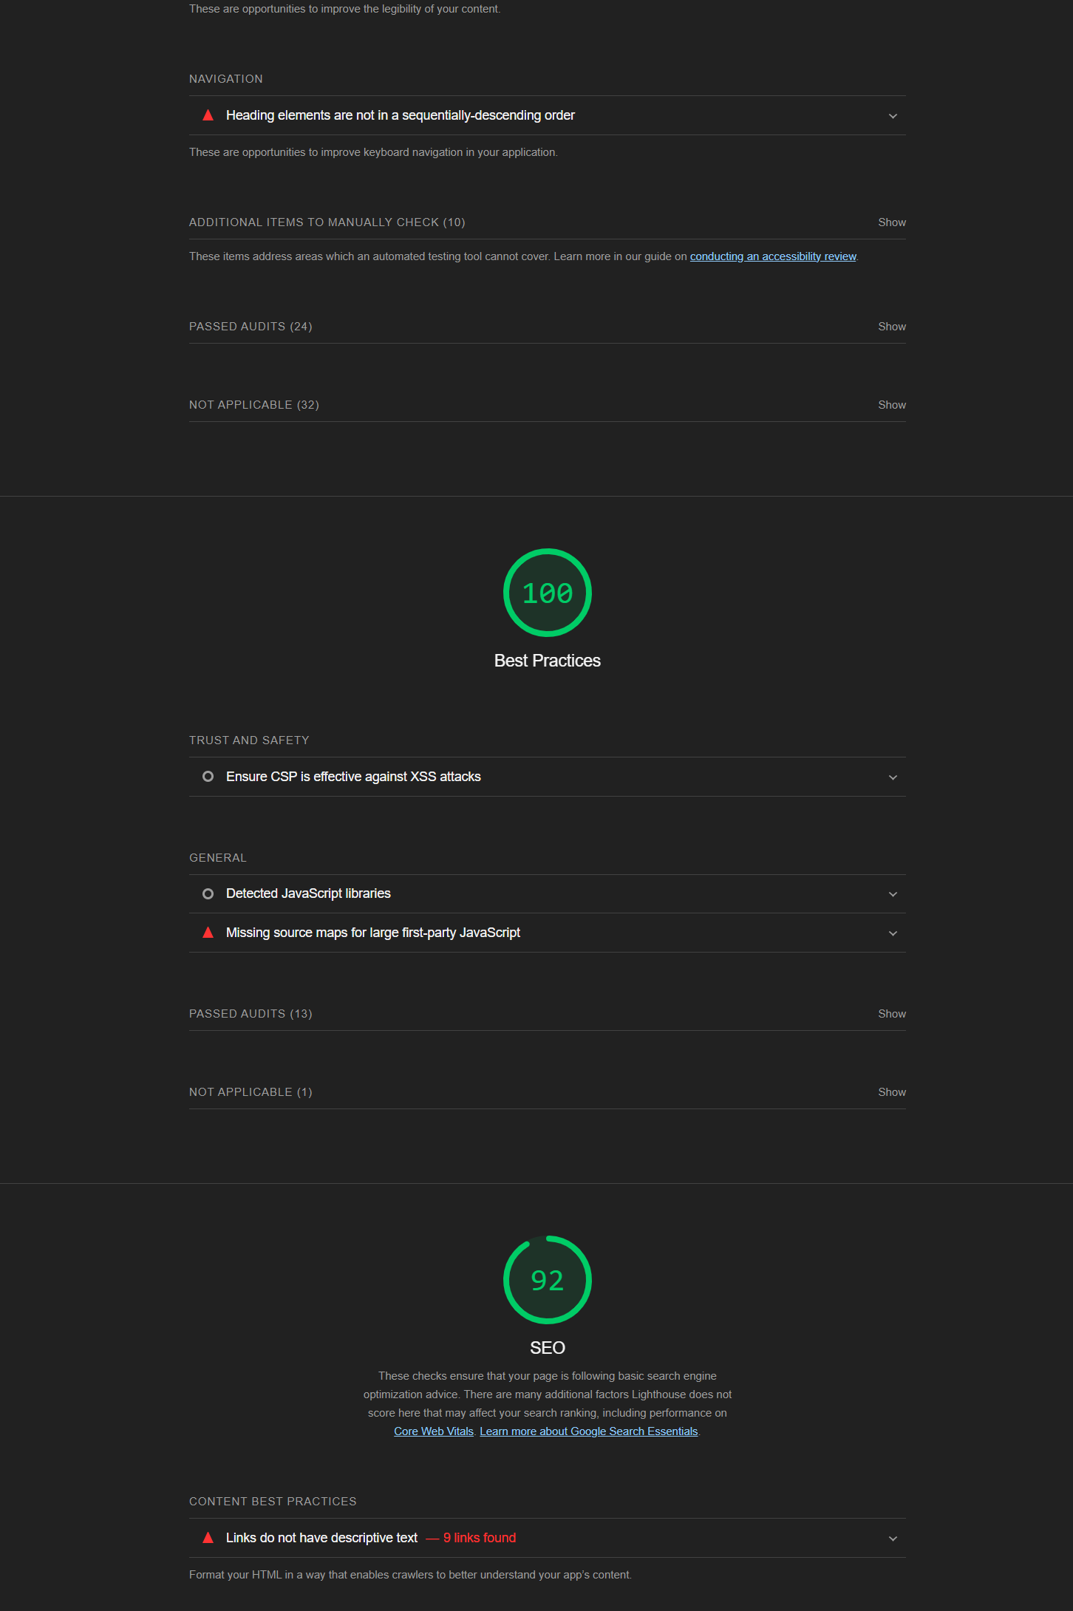
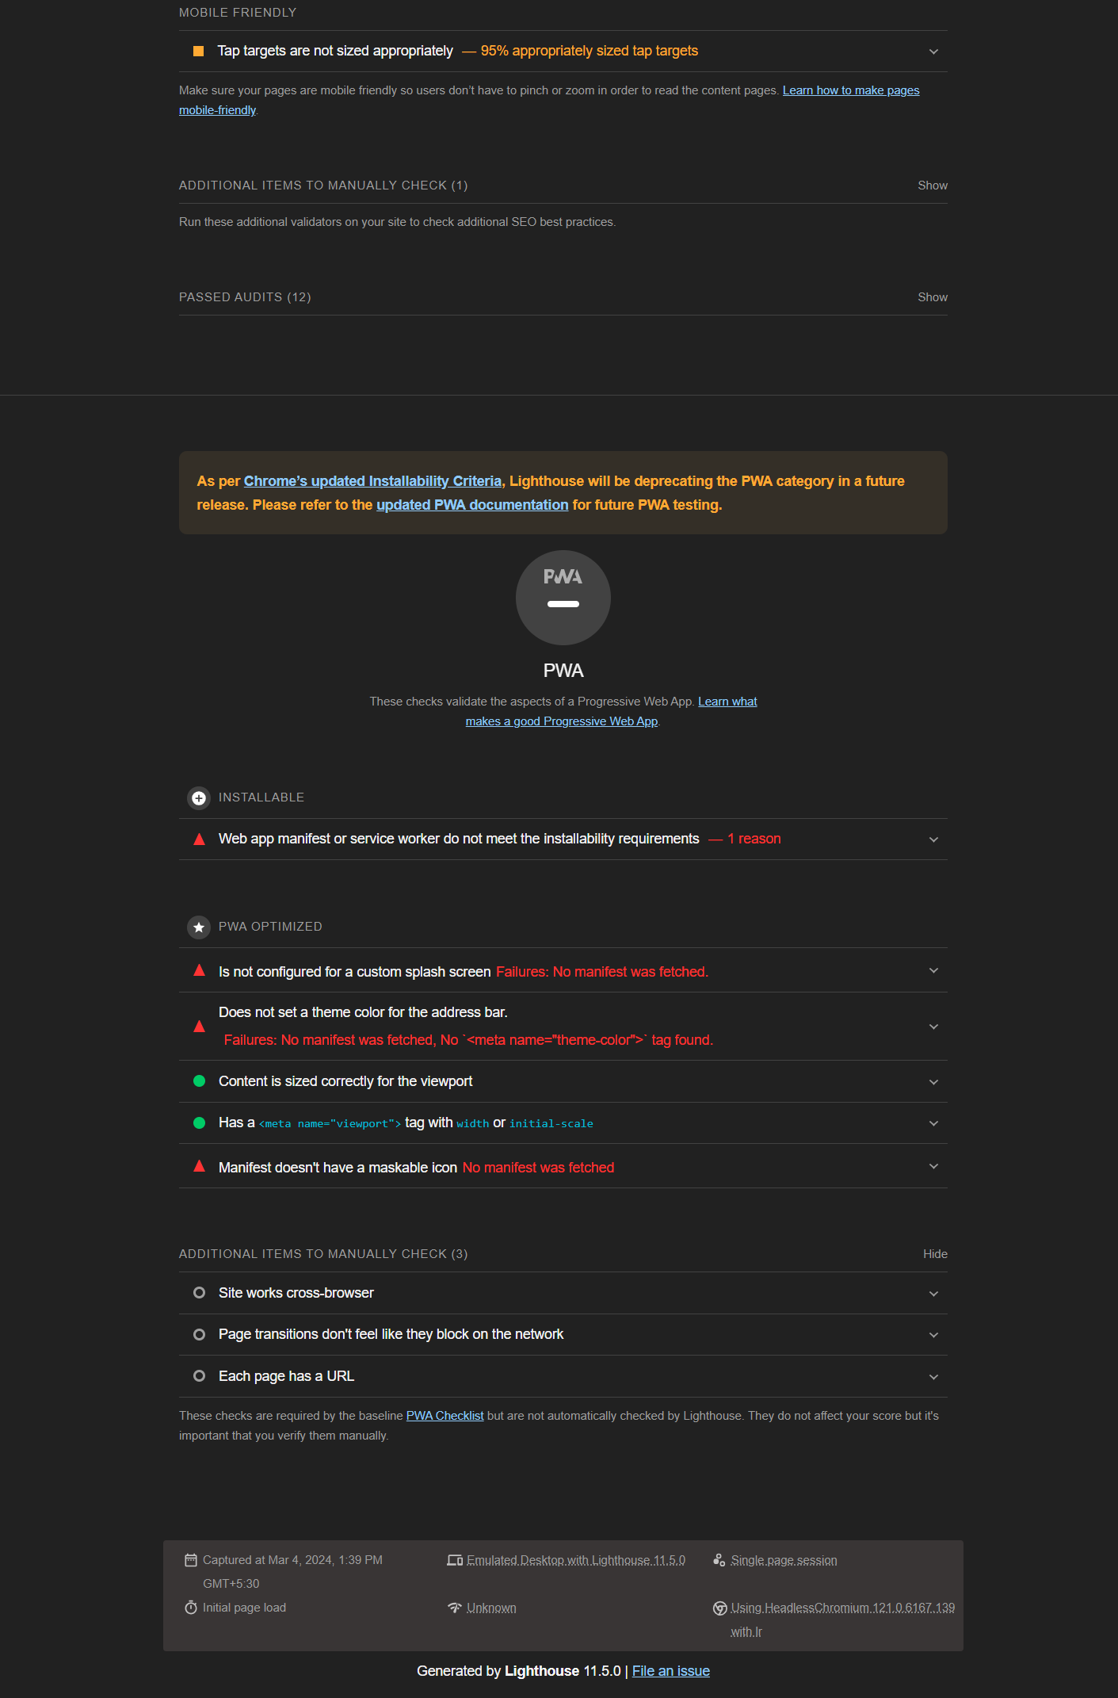

Slide 14
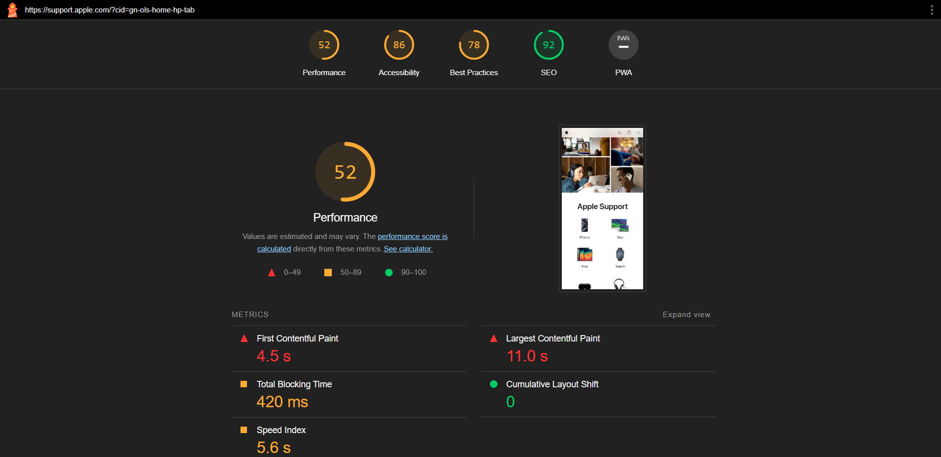
PAGE: SUPPORT

Slide 15
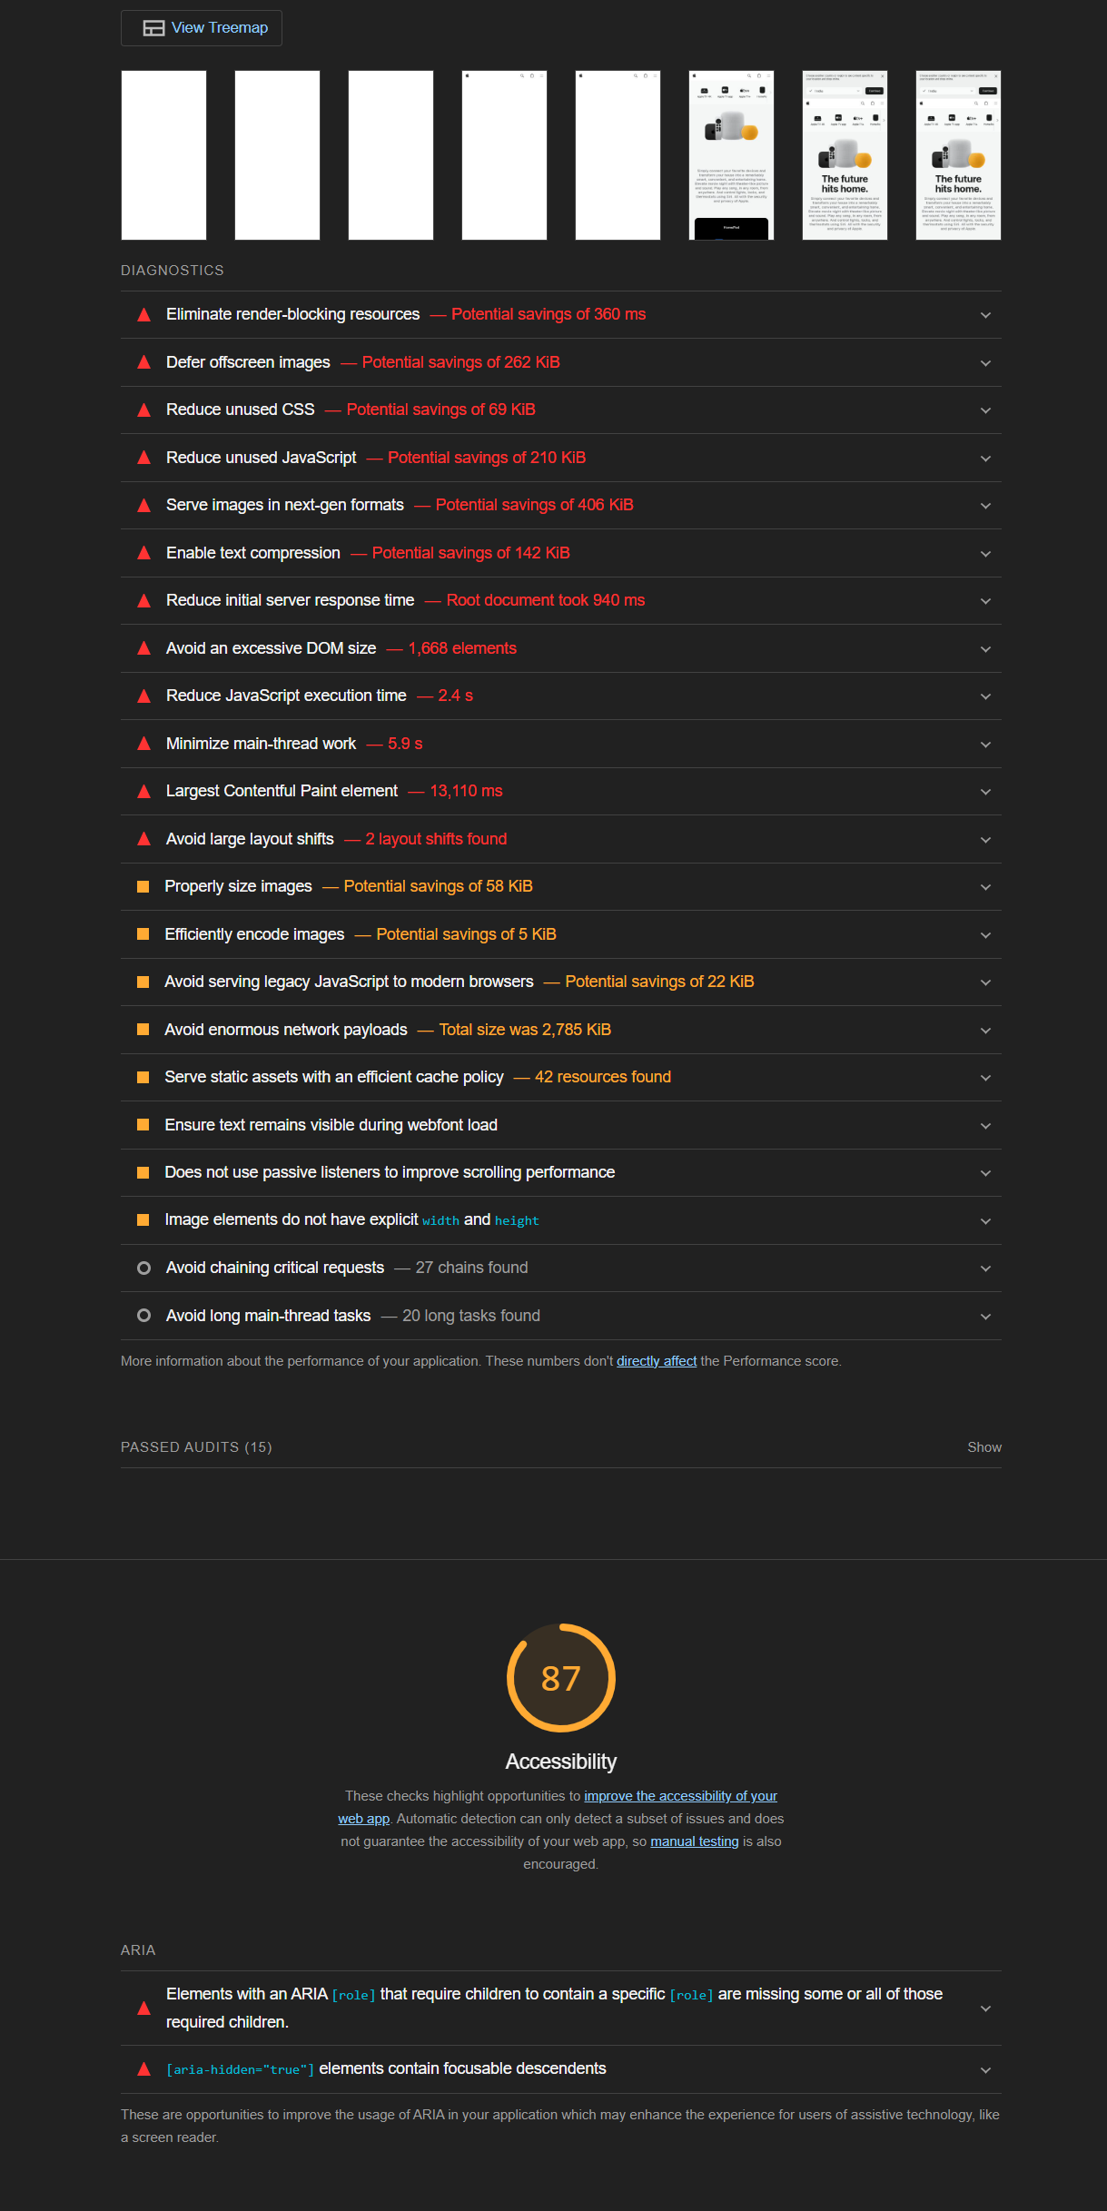
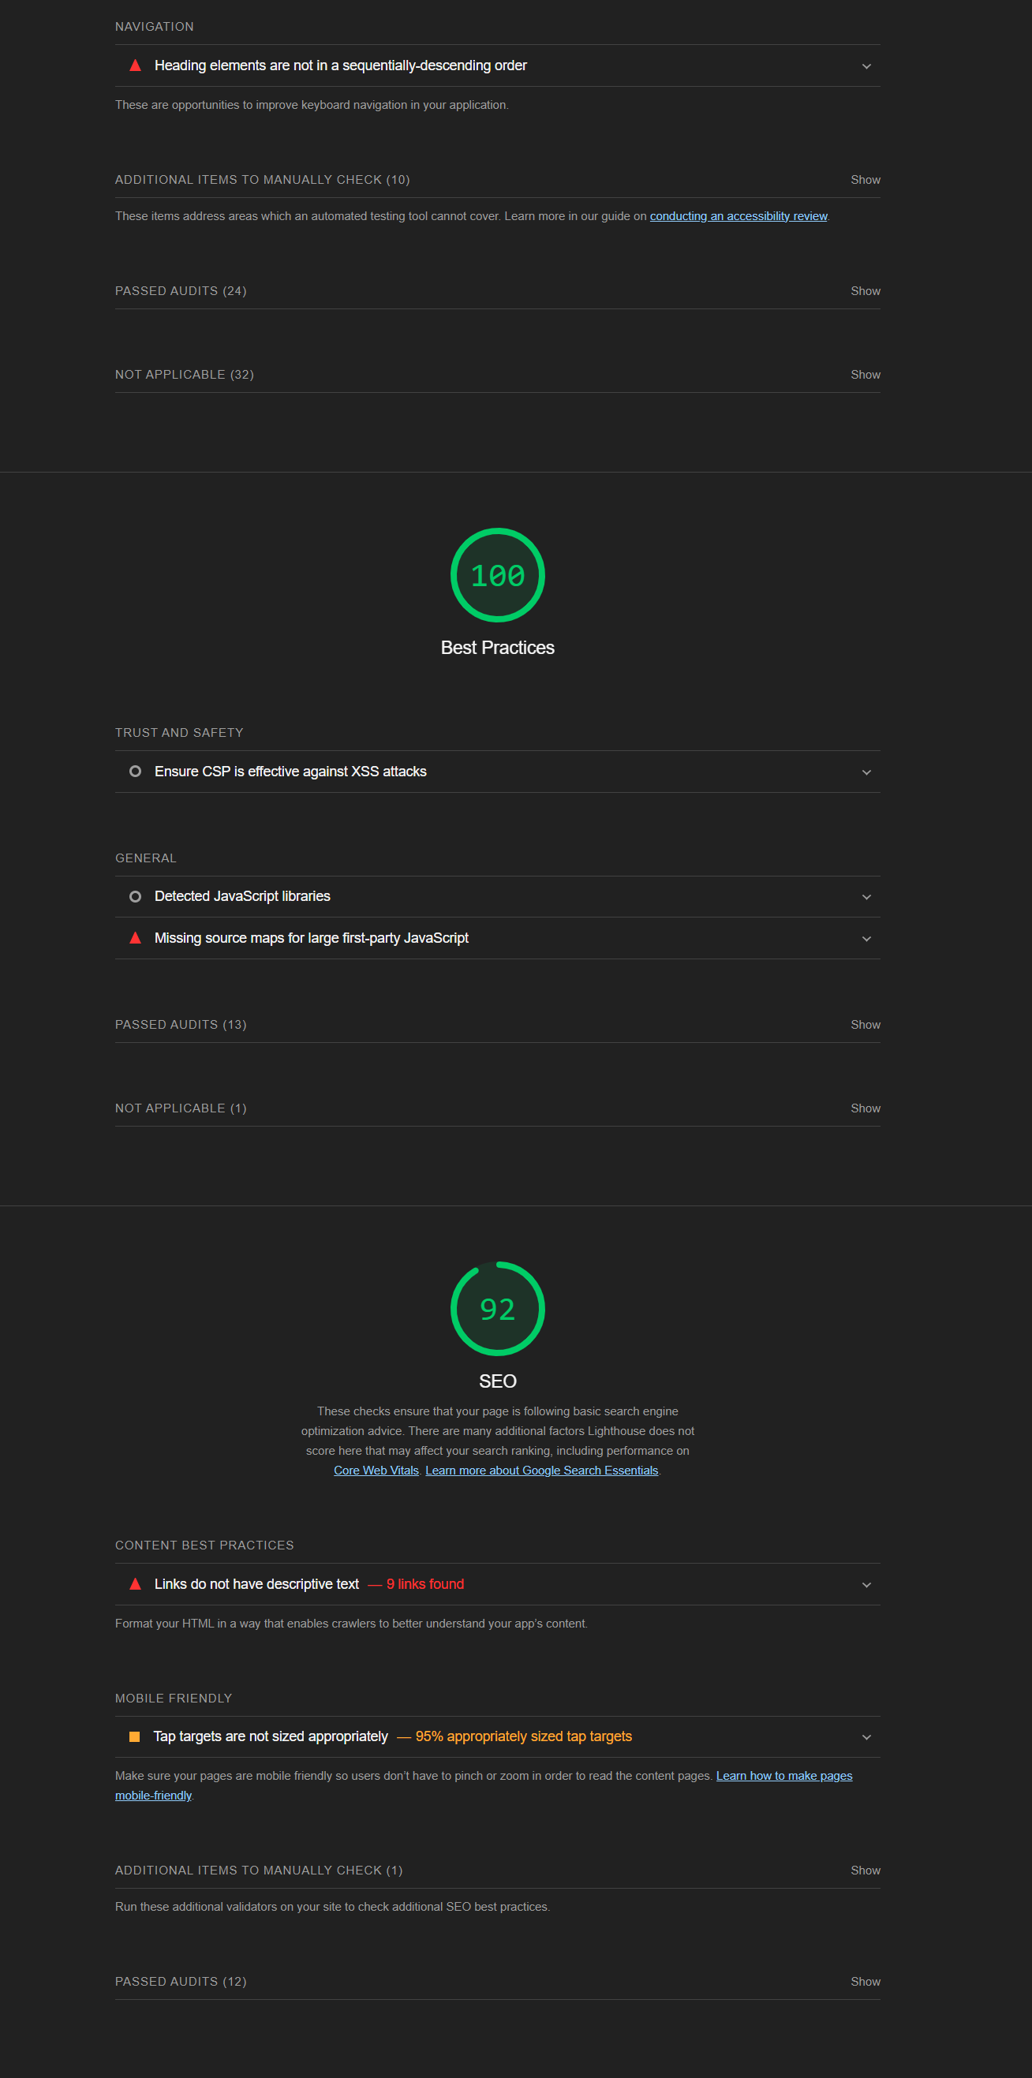
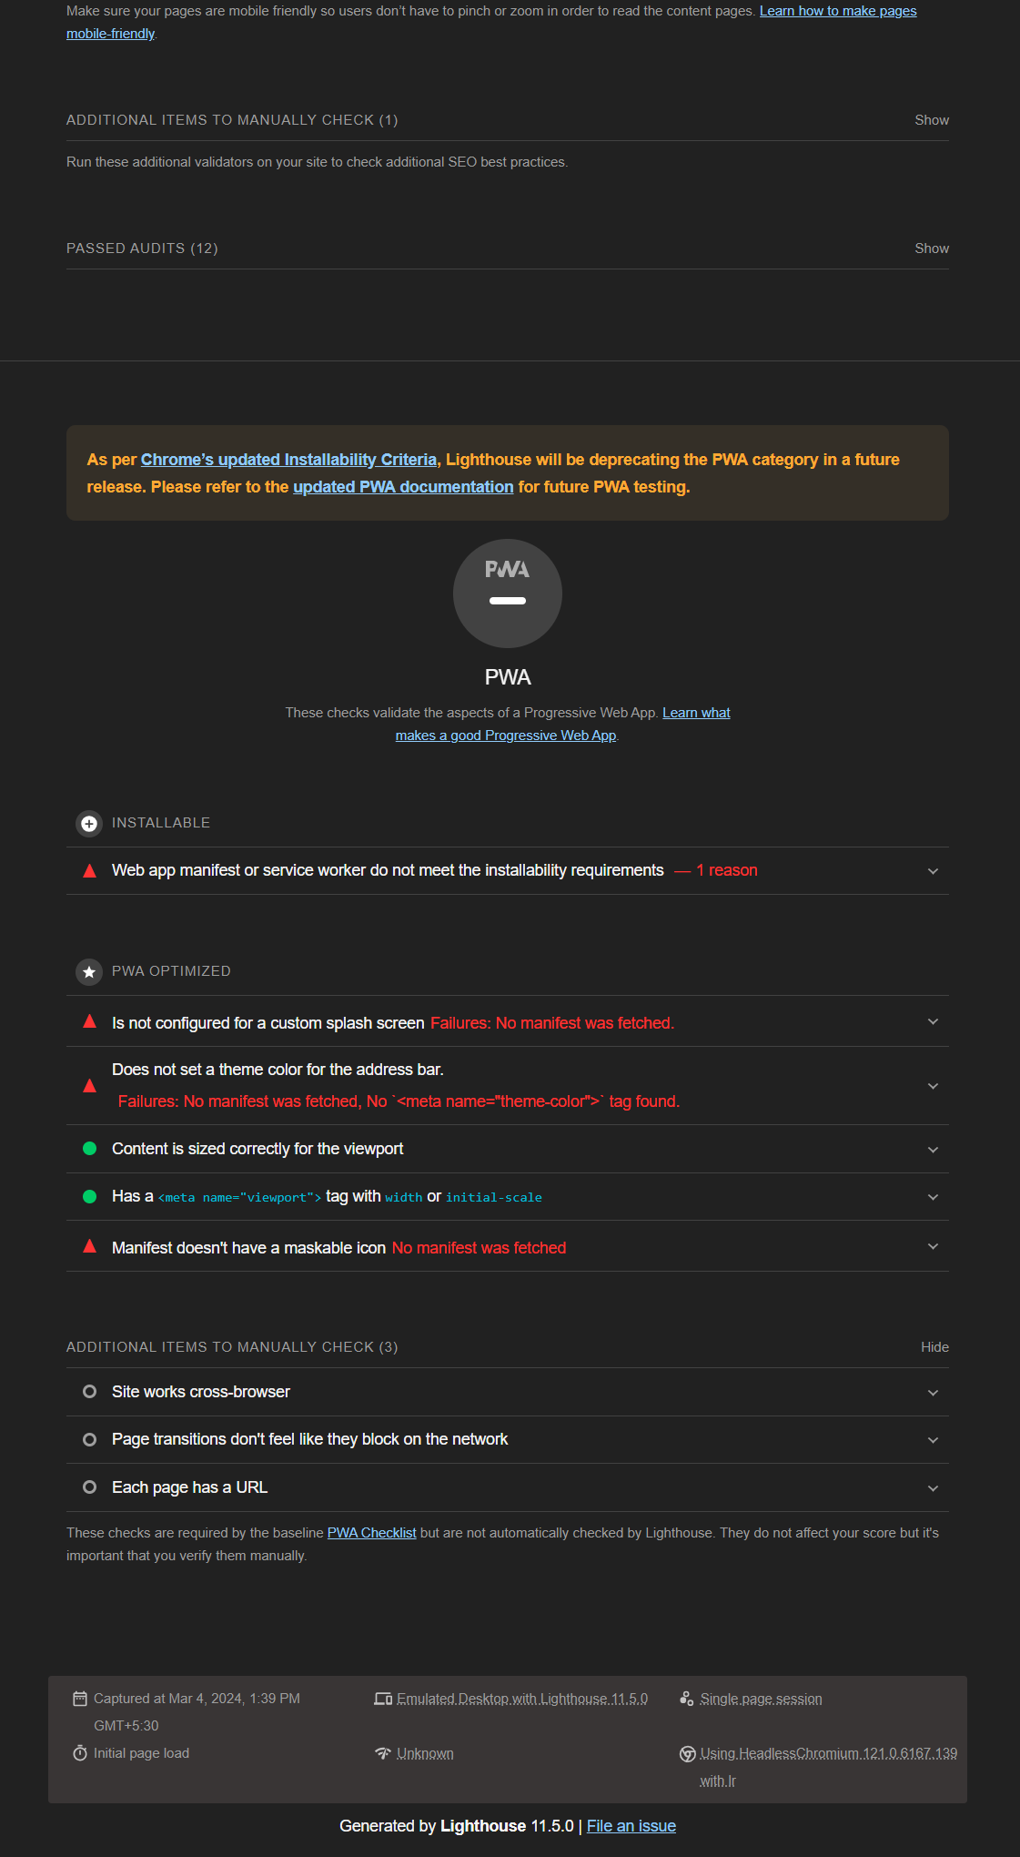

Slide 16
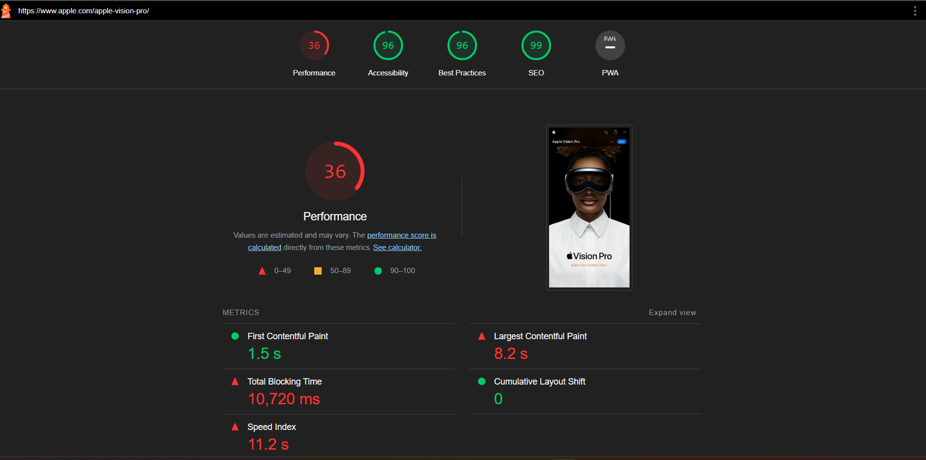
PAGE: VISION

Slide 17
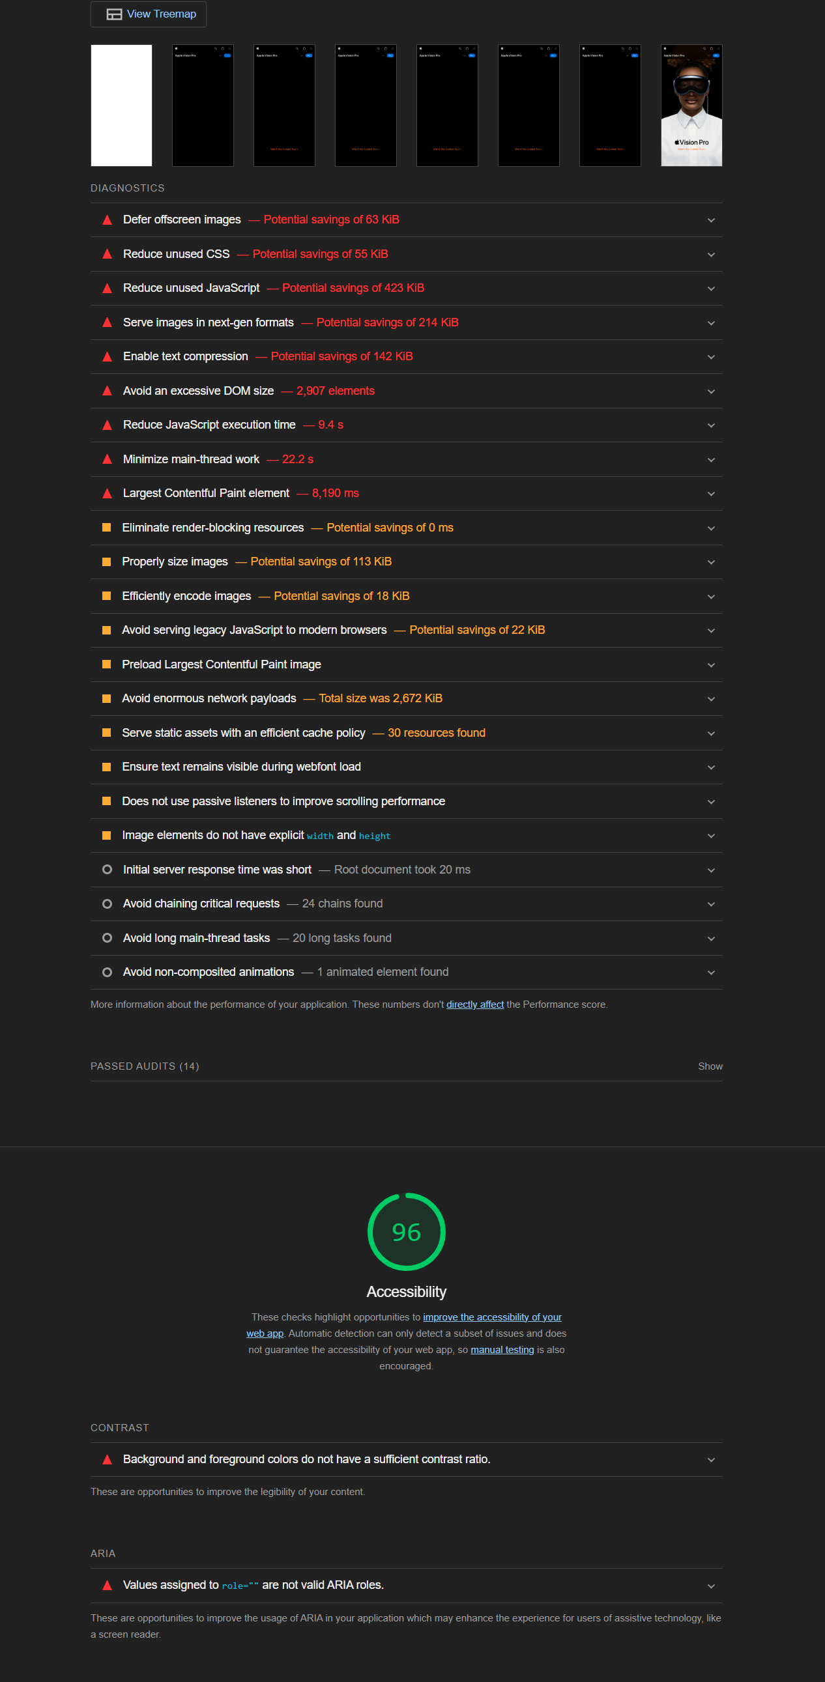
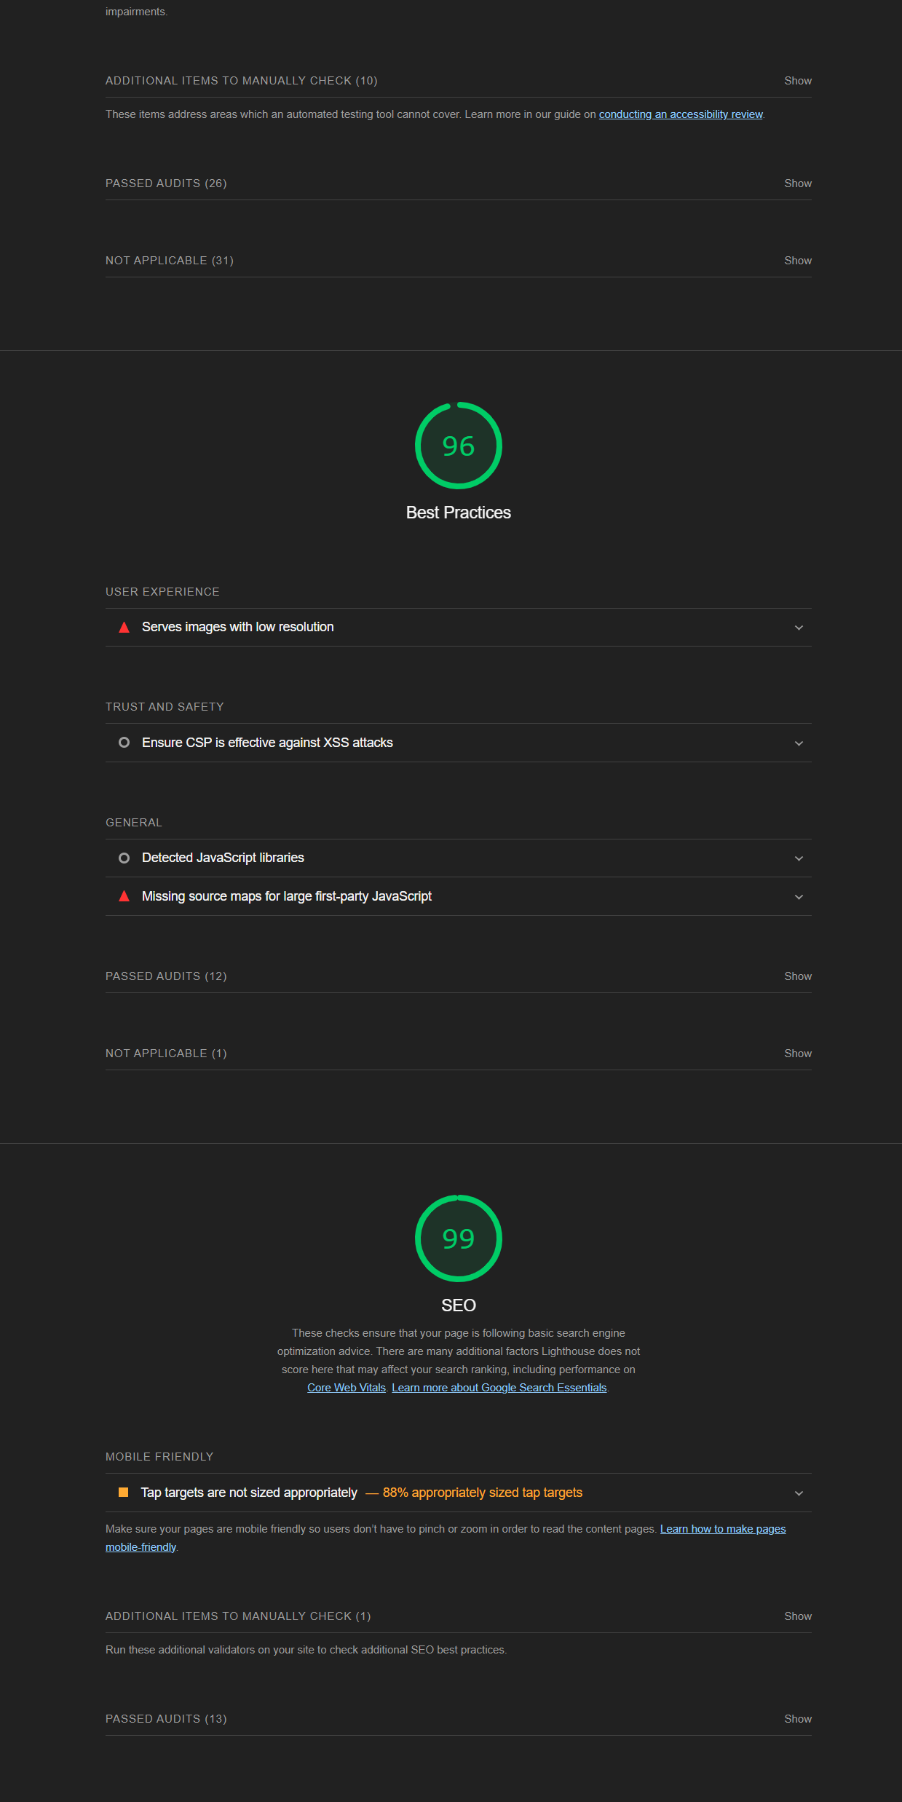
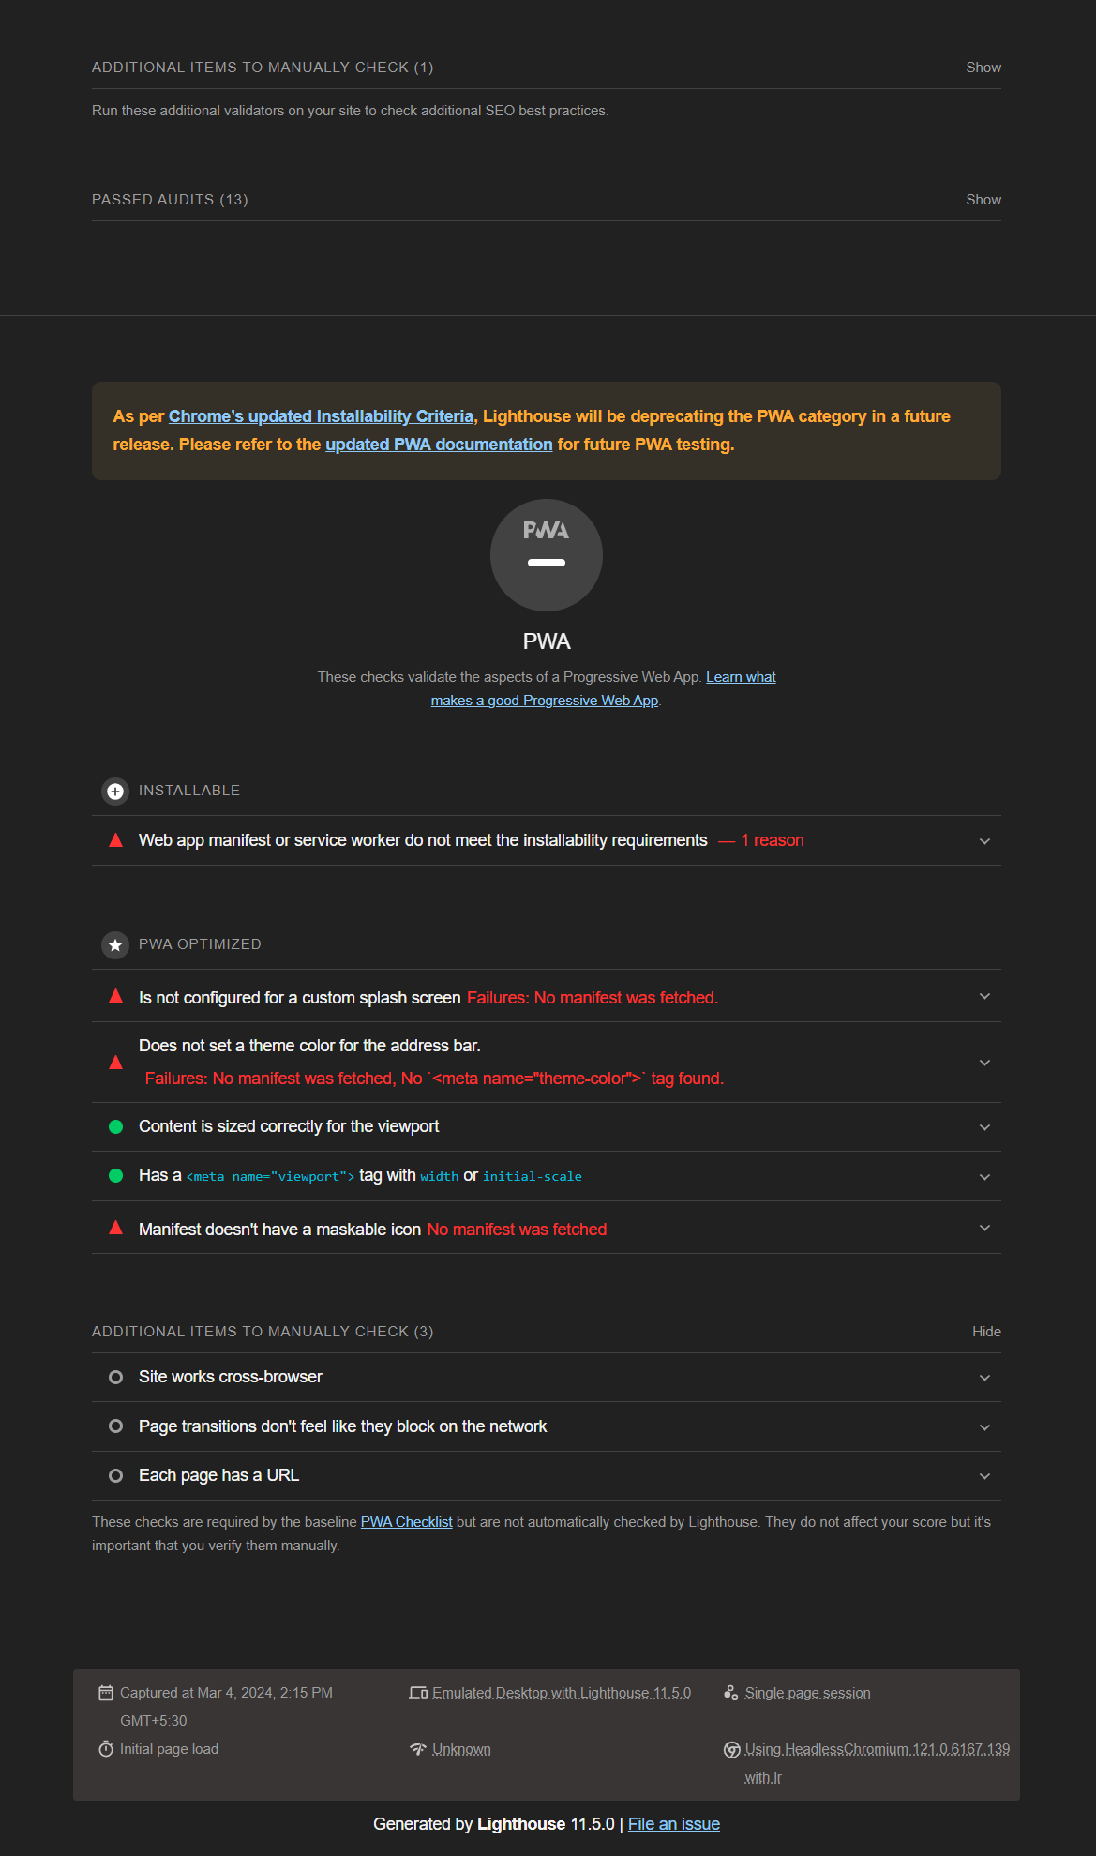

Slide 18
TASK 4 Identify common website design mistakes to avoid, such as cluttered layouts and slow loading times.
Poor Navigation:
Ensure intuitive navigation with clear menus and navigation bars.
Use descriptive labels and categories to help users find what they're looking for quickly.
Avoid excessive nesting of menus or dropdowns, which can confuse users.
Slow Loading Times:
Optimize images and multimedia files to reduce loading times.
Minimize HTTP requests by combining CSS and JavaScript files.
Use caching and content delivery networks (CDNs) to speed up website performance.
Unresponsive Design:
Ensure your website is responsive and accessible across various devices and screen sizes.
Test your website on different browsers and devices to ensure compatibility.
Use responsive design frameworks like Bootstrap or Foundation to build mobile-friendly layouts.

Slide 19
4.Inconsistent Branding:
Maintain consistency in branding elements such as colors, fonts, and logos across all pages.
Use a cohesive design theme that reflects your brand identity and values.
Avoid mixing conflicting design styles or themes that can confuse visitors.
5.Poor Readability:
Use legible fonts and font sizes for body text and headings.
Ensure sufficient color contrast between text and background for readability.
Break up long paragraphs into shorter, digestible chunks for easier reading.
6.Lack of Call-to-Action (CTA):
Include clear and compelling CTAs throughout your website to guide users towards desired actions.
Use persuasive language and placement to encourage user engagement, such as "Sign Up Now" or "Learn More".

Slide 20
TASK 5 Provide a list of best practices for creating visually appealing and user-friendly website designs.
Simplify Navigation:
Use clear and intuitive navigation menus to help users easily find the information they need.
Limit the number of menu items and organize them logically to reduce cognitive load.
Prioritize Content Hierarchy:
Use visual hierarchy to emphasize important content and guide users' attention.
Use larger fonts, bolder colors, and strategic placement to highlight key messages and calls-to-action.
Optimize Readability:
Choose legible fonts and appropriate font sizes for both desktop and mobile devices.
Ensure sufficient contrast between text and background colors to enhance readability, especially for users with visual impairments.
Use Consistent Branding:
Maintain consistency in branding elements such as colors, fonts, and logos across all pages.
Use a cohesive design theme that reflects your brand identity and values.

Slide 21
5.Utilize White Space:
Use white space effectively to improve visual clarity and reduce clutter.
Allow adequate spacing between elements to enhance readability and user experience.
6.Optimize Images and Multimedia:
Use high-quality images and multimedia content to enhance visual appeal.
Optimize file sizes to minimize loading times and improve website performance.
7.Ensure Mobile Responsiveness:
Design websites with a mobile-first approach to ensure compatibility across various devices and screen sizes.
Use responsive design techniques to adapt layout and content based on screen resolution.
8.Incorporate Visual Consistency:
Maintain visual consistency in layout, color scheme, and typography throughout the website.
Use grids and alignment to create a harmonious and balanced design

Slide 22
THANK YOU

